Slide 1
Molecular Geometry
Analysing and Computing the basic terminologies of molecular geometry

Slide 2
Contents of This Presentation
Objective
Introduction
Methodology
Bond Length
Bond Angle
Code Snippets
Code for calculating bond length
Code for calculating bond angle
Discussion and Conclusion
Reference

Slide 3
Objectives:
01.
02.
03.
04.
To devise free utility to know the about the important
information of the compound.
To apply our theoretical knowledge of computer programming into practical uses
in the domain of applied chemistry.
To explore use of coding skills especially in the field of Molecular Geometry
To equip ourselves with the prerequisite knowledge required in the field of programming and chemistry

Slide 4
Introduction
Molecular geometry is the three-dimensional arrangement of the atoms that constitute a molecule. It includes the general shape of the molecule as well as bond lengths, bond angles, torsional angles and any other geometrical parameters that determine the position of each atom.

Slide 5

Methodology
Bond Length
In molecular geometry, bond length or bond distance is defined as the average distance between nuclei of two bonded atoms in a molecule. .
Bond length is also inversely related to bond strength and the bond dissociation energy.
Formula used for interatomic Bond Length:
Where X_{i}, Y_{i}, Z_{i} are coordinates of atom 1 and X_{j}, Y_{j}, Z_{j} are coordinates of atom 2

Slide 6
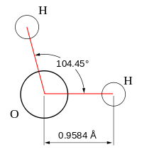

Bond Angle
The geometric angle between any two adjacent covalent bonds is called a bond angle. This bond parameter provides insight into the molecular geometry of a compound.
Formula used for interatomic Bond Angle
All the possible bond angles ɸ_{ijk}, between atoms i-j-k, where j is central atom is given by:
Where e_{ij} are unit vectors between atoms e.g.

Slide 7
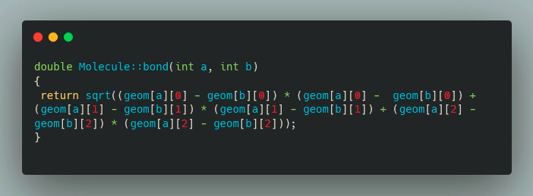
Code Snippets
Code for calculating bond length

Slide 8
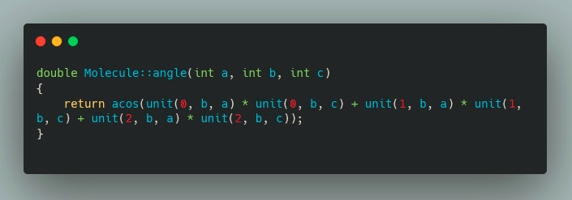
Code Snippets
Code for calculating bond angle

Slide 9
Discussion
Conclusion
Sample Taken : Acetaldehyde
The experimental ͑ theoretical’ bond lengths were C–C 2.863 Bohr ͑ 2.853 Bohr’, C–O 2.297 Bohr ͑ 2.267 Bohr’ , and C1–H 2.105 Bohr ‘2.097 Bohr’ and bond angles were C–C–O 123.92° ͑ 125° ͒ and C–C–H 117.47° ͑ 115° ͒ .
This Project will enhance our knowledge of various basic but important topics in the field of molecular geometry and also allow us to put it to use in practical scenarios. With the help of computer knowledge and chemistry theory we intend to automate these calculations for better accuracy and time saving.

Slide 10
References
Thank You :)
Made By- Yash Joshi 2K20/B14/22
Tushar 2K20/B14/58
The VSEPR Model of Molecular Geometry , By Ronald J Gillespie, Istvan Hargittai
Journal of Applied Crystallography || by Leslie Glasser ISBN:1600-5767
Openbabel.org for their pre-compiled co-ordinate data for a large variety of compounds
Computer-representation of Geometry || (ccl.et)
?
?
?
?

